Slide 1

Digital Forensic Final Report
Kali Linux VM
Adolfo T. Javier Leon
Computer Forensics 2614

Slide 2
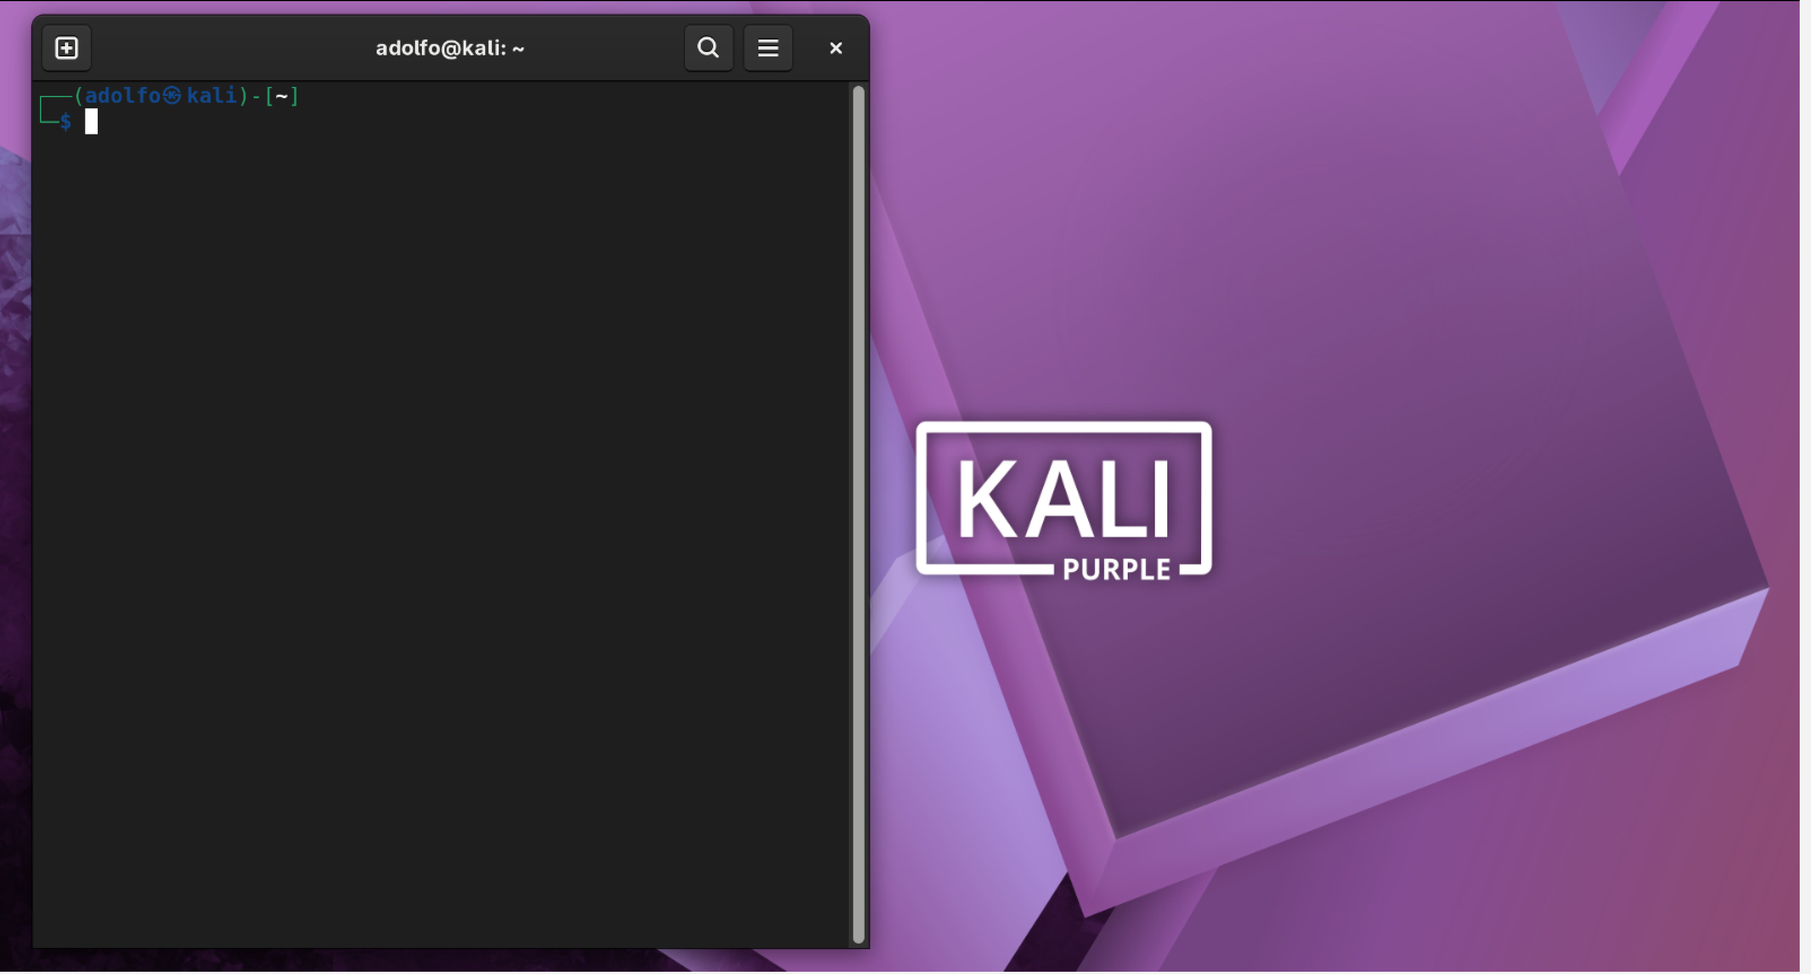
Case Overview
Target: Kali Linux VirtualBox VM
Purpose: Controlled forensic acquisition & analysis
Evidence collected:
Full disk image (E01)
Network capture (PCAPNG)
Tools used: Guymager, Sleuth Kit, Wireshark, Hashdeep

Slide 3
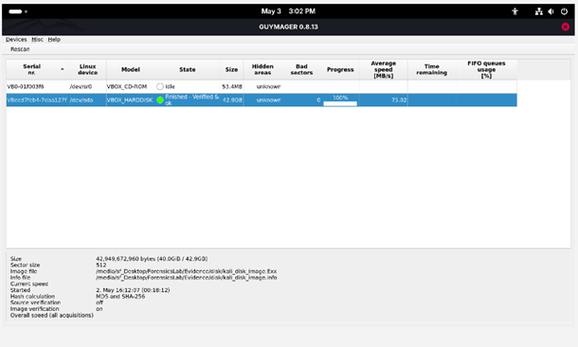
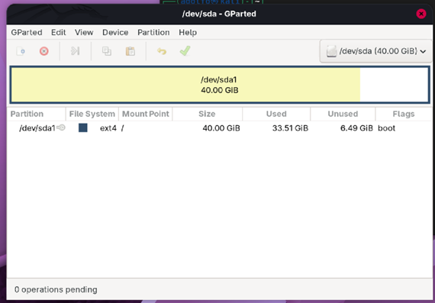
Acquisition Summary
Disk imaged with Guymager
MD5 & SHA‑256 hashes generated
Evidence stored in read‑only directory
Network capture performed on eth0
Guymager
GParted

Slide 4
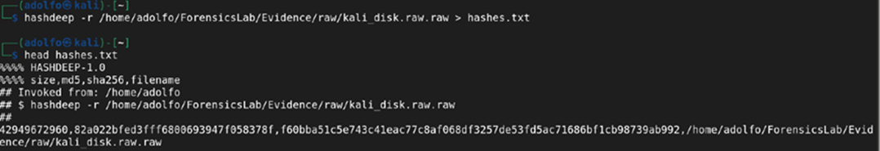
Hash Verification
MD5: 82a022bfed3fff6800693947f058378f
SHA‑256: f60bba51c5e743c41eac77c8af068df3257de53fd5ac71686bf1cb98739ab992
Hashdeep confirmed integrity of the disk image remaining unchanged
No tampering detected
4

Slide 5
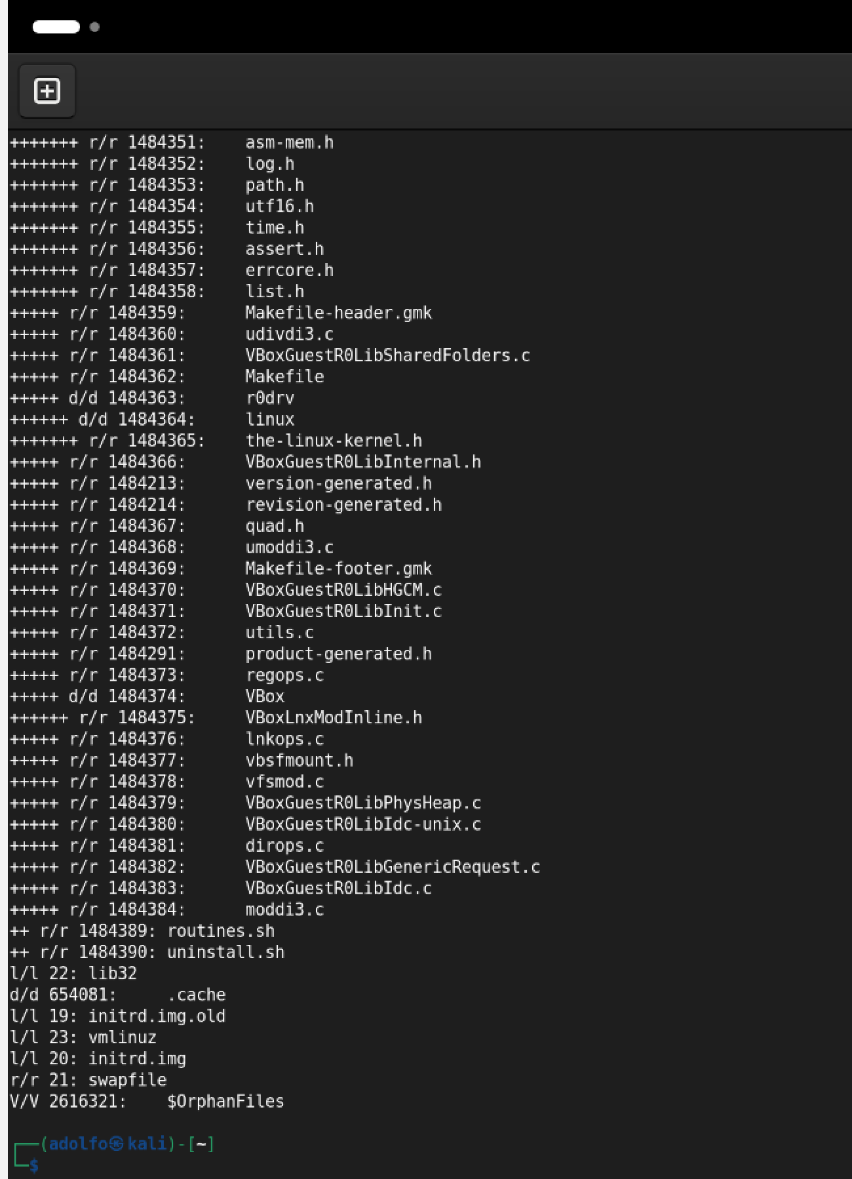
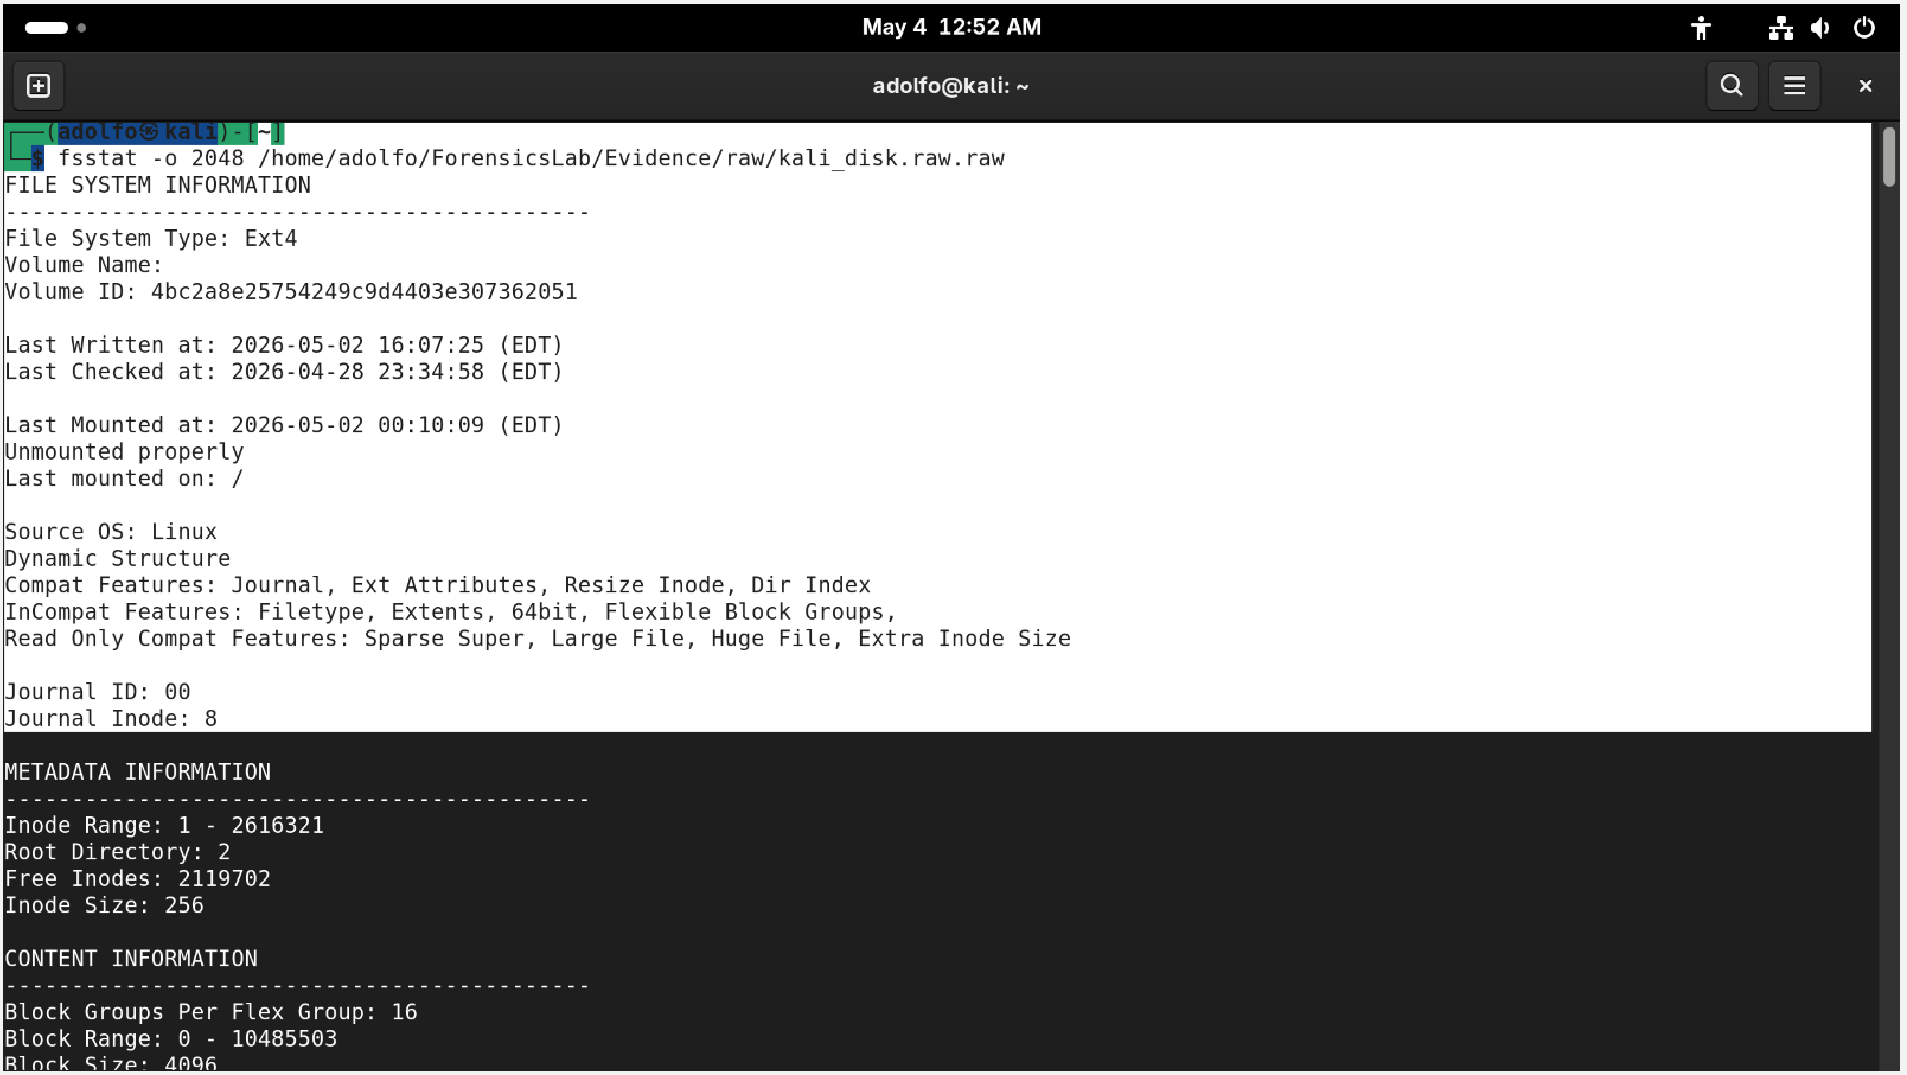
File System Analysis
EXT4 structure examined
Inodes extracted using Sleuth Kit
Using Sleuth Kit tools like fsstat, fls, and icat, I examined the EXT4 file system. Metadata showed normal timestamps and no signs of tampering
File metadata reviewed
No unauthorized modifications detected
fls
fsstat
5

Slide 6
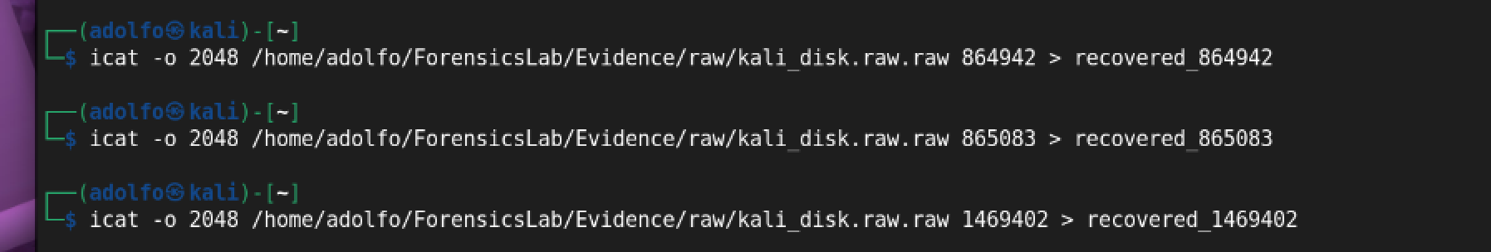
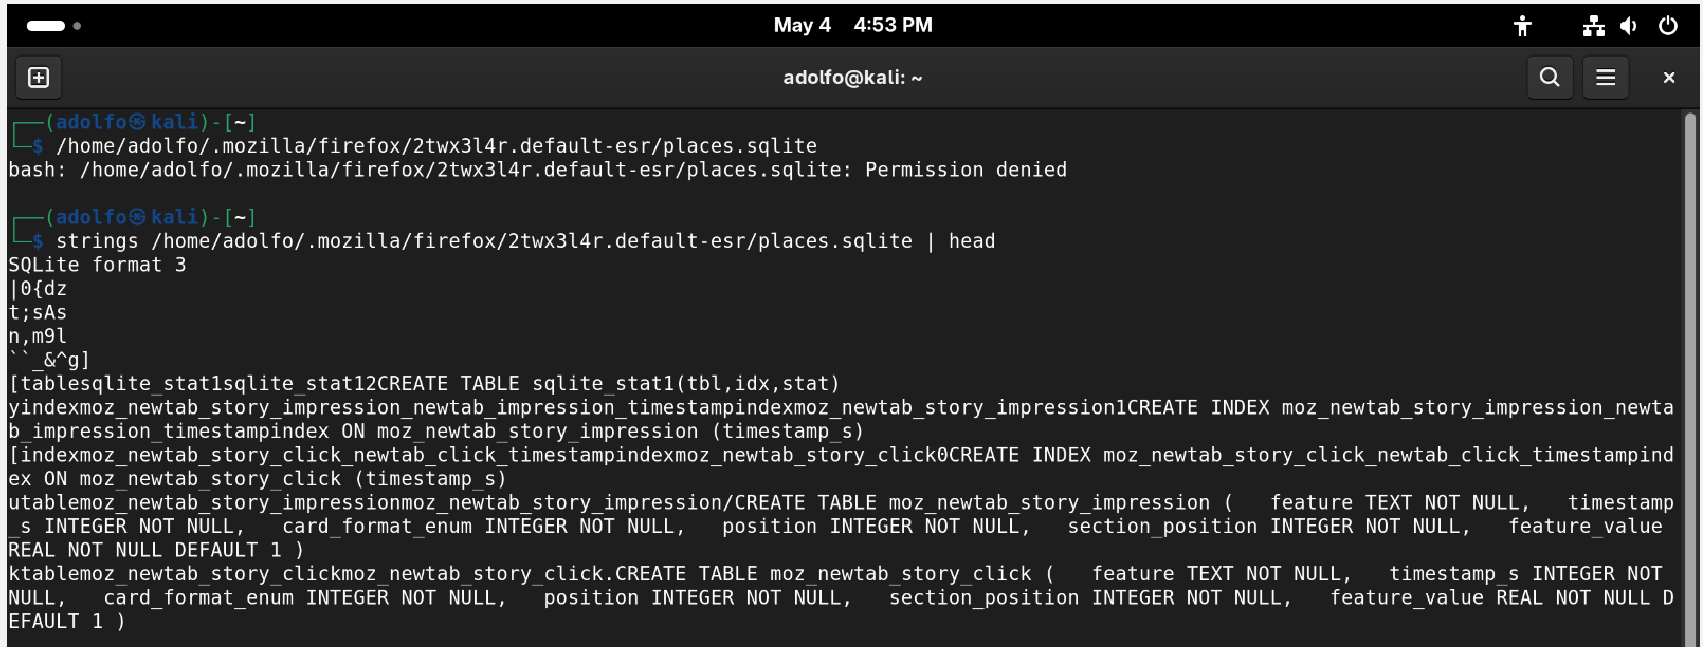
Recovered Files
Three DLLs recovered
Disk Image, strings analysis showed only system content
Inodes: 864942, 865083, 1469402
Strings analysis: benign content
No malware indicators
DLLs
Strings

Slide 7
Browser Artifact Analysis
places.sqlite examined
Normal browsing activity
No suspicious URLs
No downloads or redirects
7

Slide 8
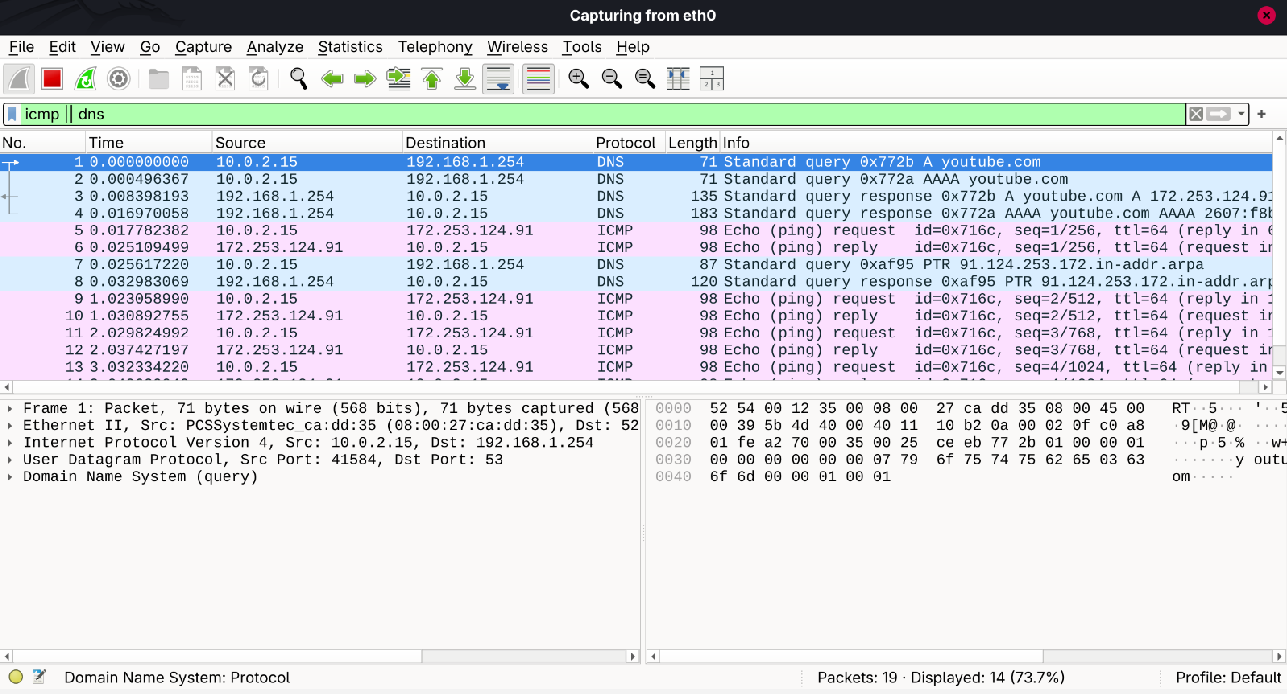
Network Capture Analysis
- DNS lookup for youtube.com
The network capture contained only DNS, ICMP, and HTTPS traffic related to YouTube.
- ICMP echo requests (ping)
- HTTPS traffic to YouTube CDN
- No malicious traffic
8

Slide 9
Additional System Behavior
Application‑level SMTP errors observed
These appear to be from a misconfigured mail client and are not related to malicious activity
Not related to malware
Likely misconfigured mail client
No impact on system integrity
9

Slide 10
Conclusion
No evidence of compromise
No malware detected
No unauthorized changes
System behavior consistent with normal use
Evidence integrity fully preserved

